Slide 1
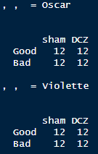
PST50 OsVi
1st analyses

Slide 2
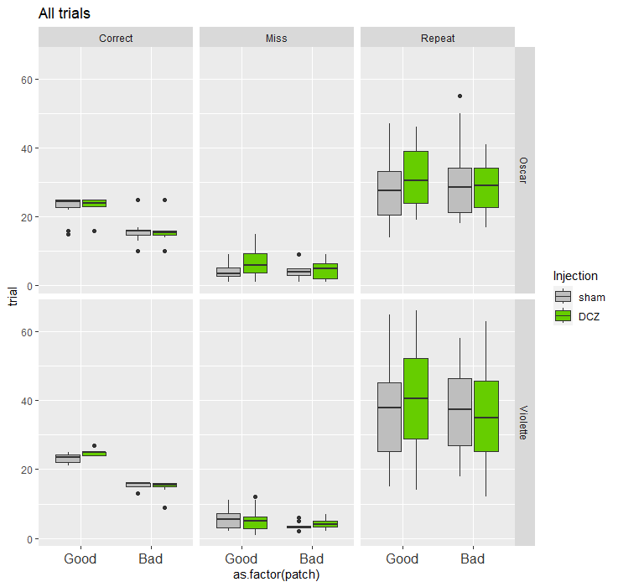
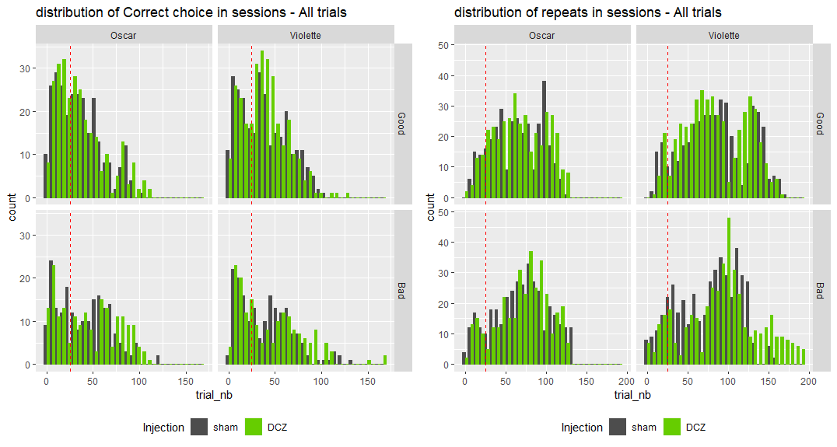

Slide 3
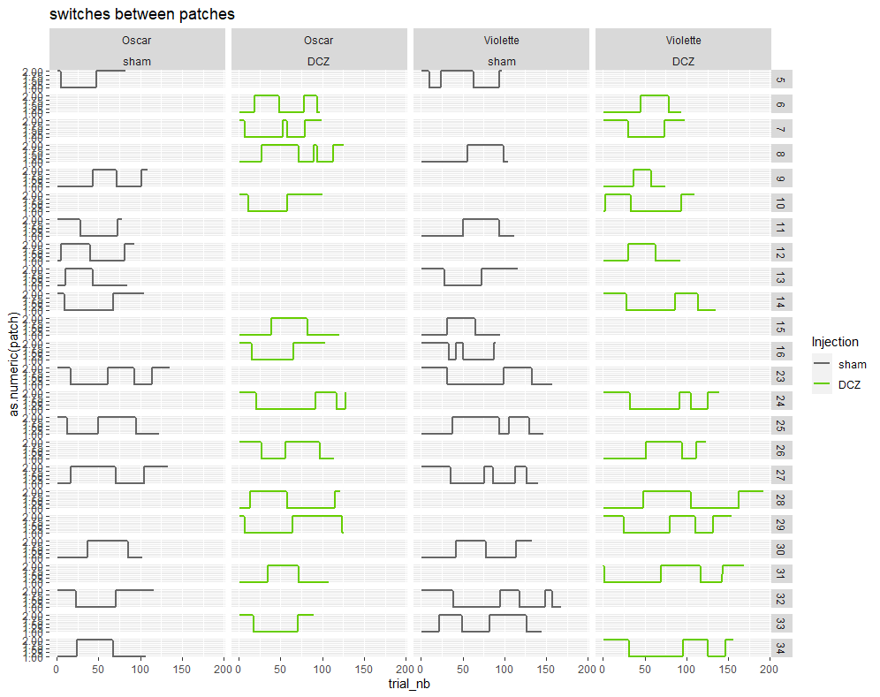
ns
ns

Slide 4
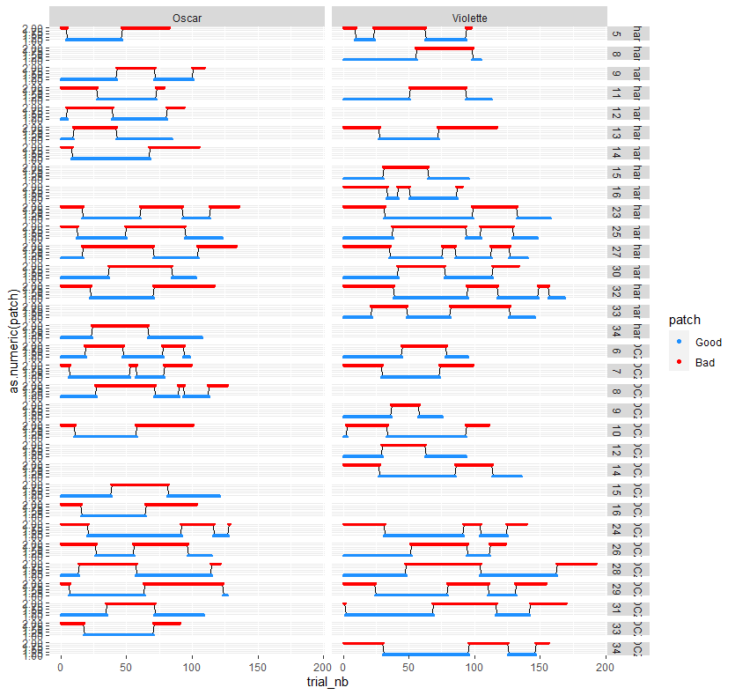

Slide 5
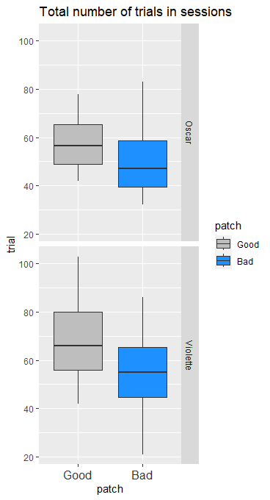
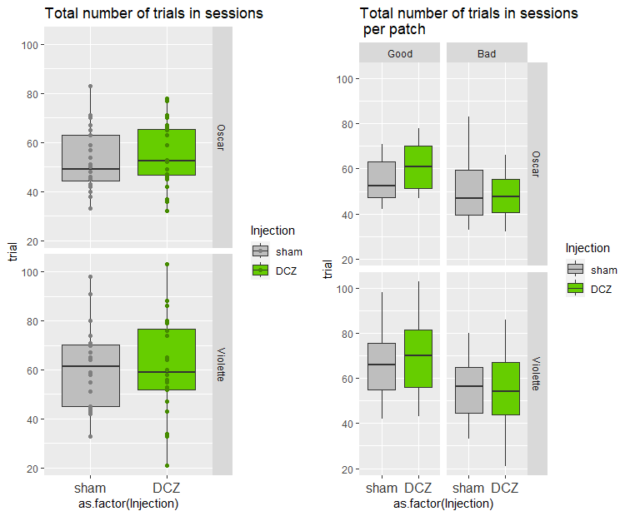
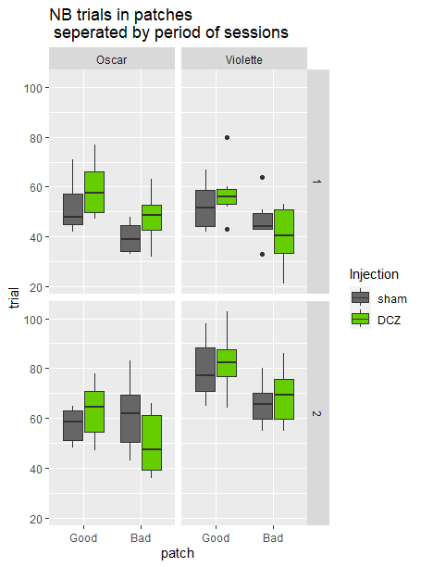
***
ns
* Injection
. Patch x Injection
ns
***
ns
patchBad:InjectionDCZ: 0.021408 *
sessrand 9.11e-09 ***
patchBad:InjectionDCZ 0.0465 *
patchBad:InjectionDCZ:sessrand 0.0888 .
No change in the total number of trials number of trials between DCZ and Sham.
Both monkeys stays less in the bad patch compared to the good one, but there is an interaction with DCZ for Oscar who stays even longer in the good patch under DCZ.
This might suggests that under DCZ-NA activation the animals are more prone to keep exploring the good patch.
However, sessions were made in 2 groups and it seems this is an influent factor. See next figure on the right
Regarding the number of trials spent in the different patches:
There is a strong effect of session group (1 vs 2) for Violette (***; see offset of trial numbers).
Violette has an effect of DCZ x patch () with a tendency for an additional interaction with the session group.
Oscar shows a significant interaction of all factors, i.e. the effect of DCZ x patch changing with group of sessions.
The 2 monkeys spend less time in the less rewarded patch
There is thus an overall tendency for animals to spend more time in good patch under DCZ although the difference with bad patch varies with session groups.

Slide 6
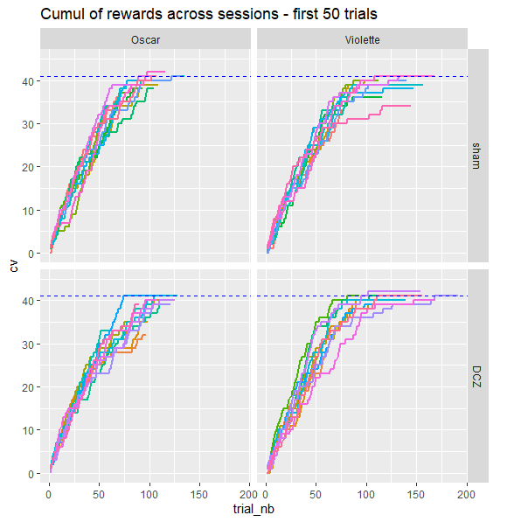
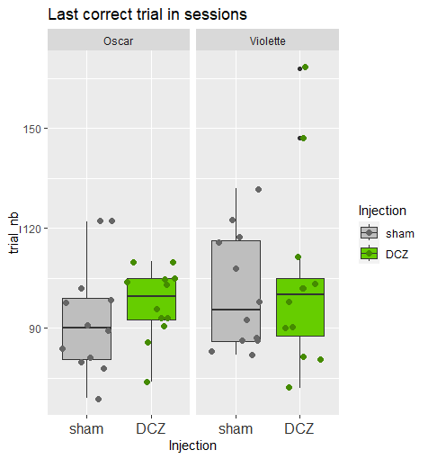
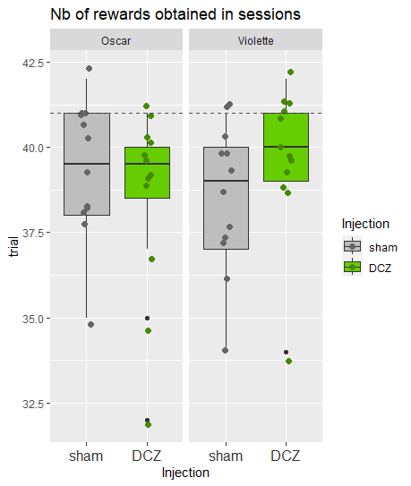
Do animals take longer to rewards? , which would be the consequence of alterred search patterns, or default in switch between patches (there are 41 rewards in total).

Slide 7
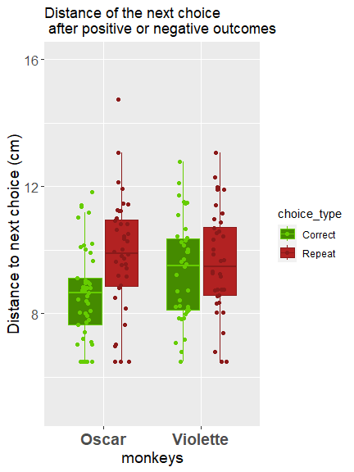
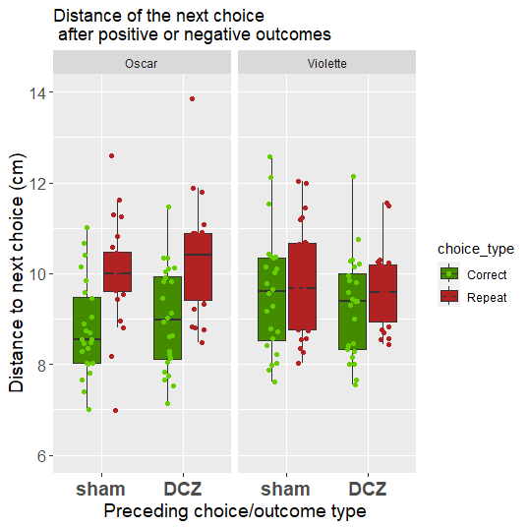

Slide 8
